Slide 1
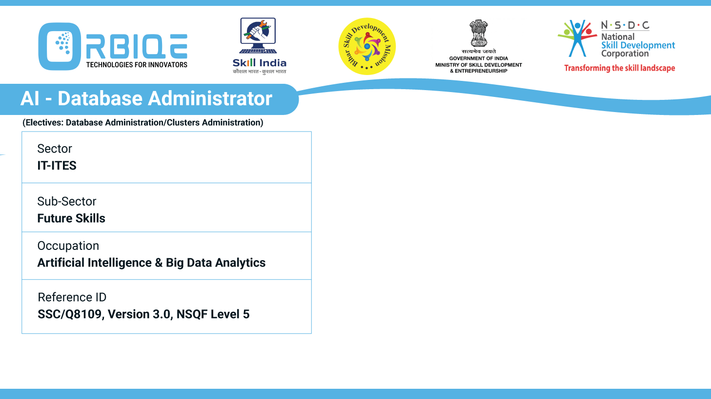
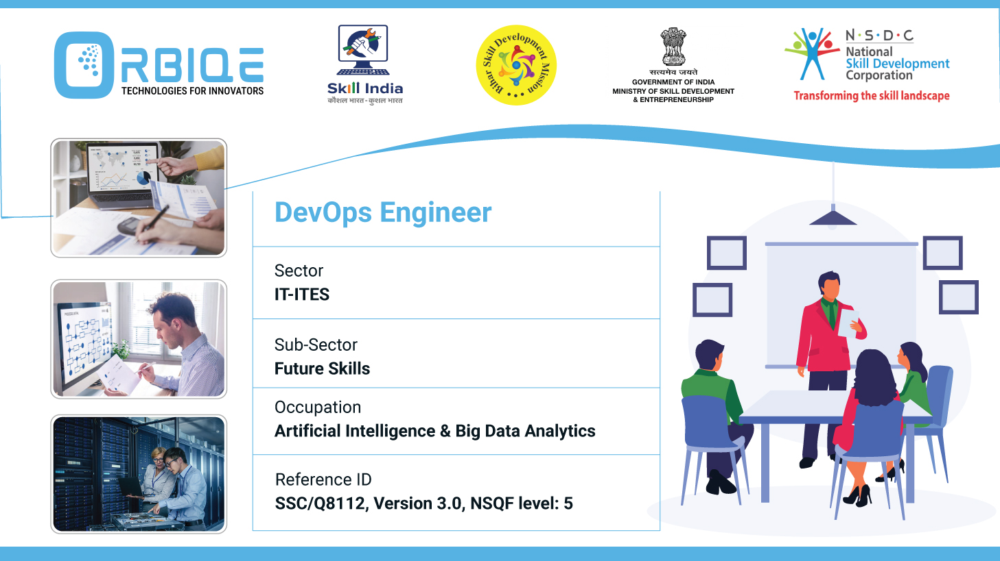
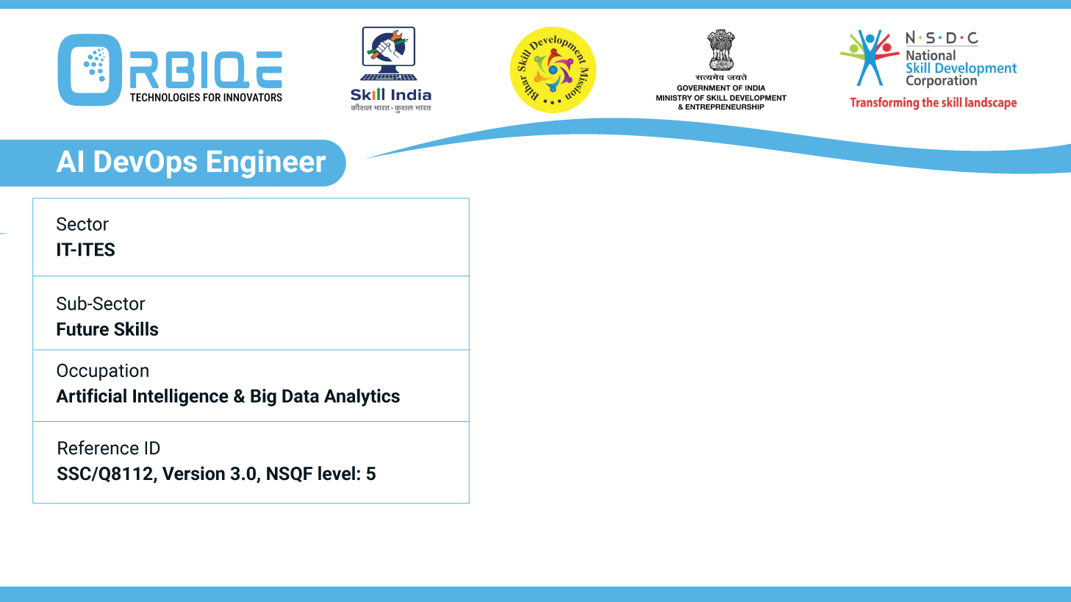
Name- Krishna Kant Dubey

Slide 2

Emerging Trends in Database Technology

Slide 3
Agenda
Stay current with the latest trends in database technology, gaining insights into innovations and advancements shaping the future of AI Database Administration

Slide 4
latest trends and advancements
AI-Powered Database Optimization
Cloud-Native & Multi-Cloud Databases
Rise of Multi-Model & Specialized Databases
Generative AI & Natural Language Interfaces
Enhanced Security & Compliance
Autonomous & Self-Healing Databases
DevOps & Infrastructure-as-Code (IaC) Integration

Slide 5
AI-Powered Database Optimization
Self-Optimizing Queries: ML models analyze query patterns and adjust execution plans in real time.
Predictive Maintenance: AI forecasts system failures and bottlenecks before they occur.
Autonomous Indexing: AI tools suggest and implement indexes based on usage trends.

Slide 6
Cloud-Native & Multi-Cloud Databases
Serverless DBMS: Automatically scale based on demand (e.g., Aurora Serverless, Google Cloud Spanner).
Multi-Cloud Compatibility: Databases like Snowflake and Databricks support cross-cloud deployments.
DBaaS (Database-as-a-Service): Offloads routine tasks like backups and scaling

Slide 7
Rise of Multi-Model & Specialized Databases
Multi-Model Systems: Support relational, document, graph, and key-value models in one backend (e.g., ArangoDB, OrientDB).
Vector Databases: Designed for AI workloads and semantic search (e.g., Pinecone, Weaviate).
Real-Time Analytics Engines: In-memory and columnar databases like ClickHouse and Apache Druid are booming

Slide 8
Generative AI & Natural Language Interfaces
NLP for Querying: Users can ask questions in plain language and receive structured results (e.g., ChatGPT plugins, Google’s Data QnA).
Automated Reporting: AI generates insights and dashboards without manual scripting.
Schema Discovery: NLP tools help identify relationships and anomalies in complex schemas.

Slide 9
Enhanced Security & Compliance
Behavioral Monitoring: AI detects unusual access patterns and credential misuse.
Shadow Data Detection: Identifies unmanaged datasets that pose compliance risks.
Confidential Computing & Blockchain Audits: Emerging techniques for secure, verifiable data governance

Slide 10
Autonomous & Self-Healing Databases
Self-Managing Systems: Handle backups, patching, and performance tuning automatically (e.g., Oracle Autonomous Database).
AIOps Integration: Combines observability with predictive analytics for proactive issue resolution.
Reduced Downtime: AI-driven systems cut resolution time from hours to minutes

Slide 11
DevOps & Infrastructure-as-Code (IaC) Integration
Declarative DB Configurations: Tools like Terraform and dbt manage schema and infrastructure as code.
Automated Testing & Rollbacks: AI-enhanced validation ensures safe deployments.
Continuous Delivery: Faster feature rollouts with fewer failures.

Slide 12
Thank You

